Slide 1



MOBILE APP -DEVELOPMENT

Slide 2

Top coders
Shivam Tripathi
Dev Kant
A.S.G.Praveen
G.Tarun
T.Aishani
C.Prashanthi
K.Anjum
M.Prathyusha
G.Sreelatha
D.Shaheen

Slide 3

BRAIN STORMING
APP FOR HOUSEHOLD SERVICES-
We are providing a common platform for service providers and users so that they can interact each
other
Users and service providers can create their own accounts
Hence our app is ease of use and consumes very less time and is very efficient.

Slide 4
USER research
SCOPE:
Our target market is all the families who are disgusted with the household works.
We need user persona because we need to find wants of users. This is vital for developing successful product.
We made our app with an ease to users. It is economically affordable for every one.
By making user persona we can know what are the current patterns of many users.

Slide 5

BUSINESS STRUCTURE
Market Requirement
need help with small but important household chores.
A platform to find trusted service providers, who deliver consistently impeccable house hold services.
Looking for a platform for ordering household services just like ordering food with one click.
Problems with conventional house hold services
Less Secure
Service requested is not processed in time
Less trustworthy
Fee and service charges are not accountable

Slide 6

UNIQUE FEATURES OF OUR APP
Our app is done with the help of react native so that it can run on both IOS and android versions.
A large number of household services are provided
Common platform is created between the user and the service provider.
Ease of use.

Slide 7
SWOT ANALYSIS
STRENGHTS
THREATS
IMPERSSION OF INCOMPETENCE
OPPORTUNITIES
LARGE TARGET MARKET
SMALL COMPANY
WEAKNESSES
LOWER EMPLOYEMENT COSTS.
TIME SAVING AND MANAGEMENT
WELL TRAINED AND HIGHLY MOTIVATED TEAM
STORNG ,LOYAL AND EDUCATED COMMUNITY
LIMITED GROWTH
ONLY POSSIBLE WHEN THERE IS NET ACCESS
HIGH COMPETETION
LACK OF RESOURCES

Slide 8
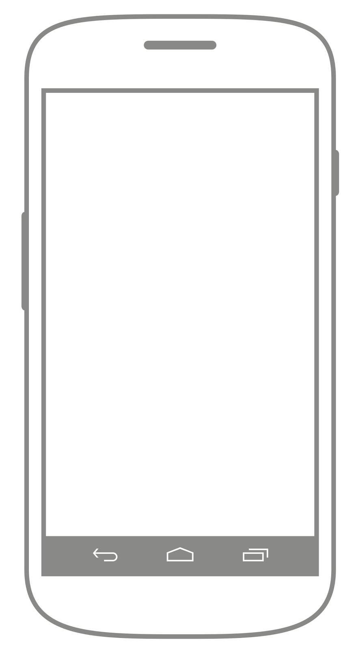
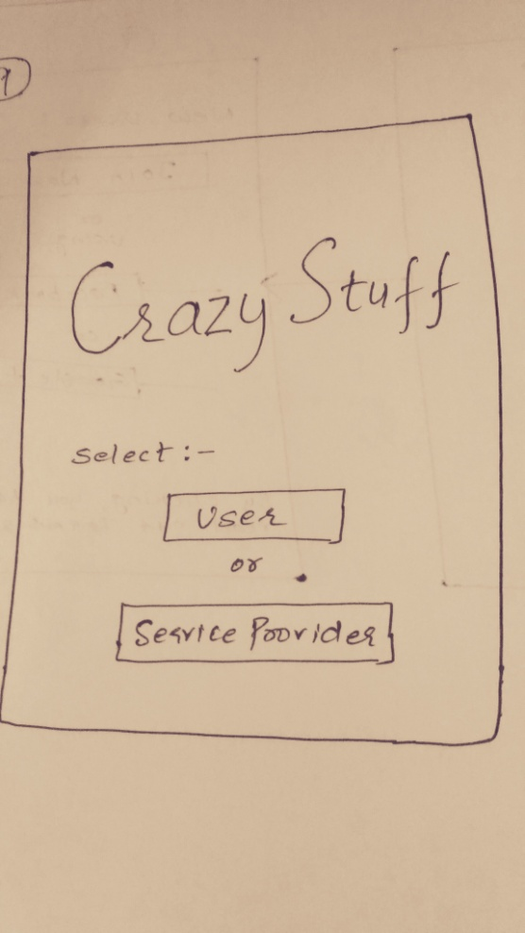
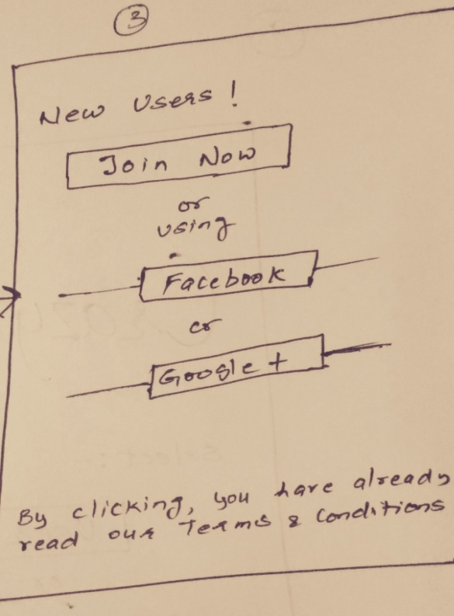
PAPER PROTOTYPE FOR APP
LOGIN PAGES

Slide 9
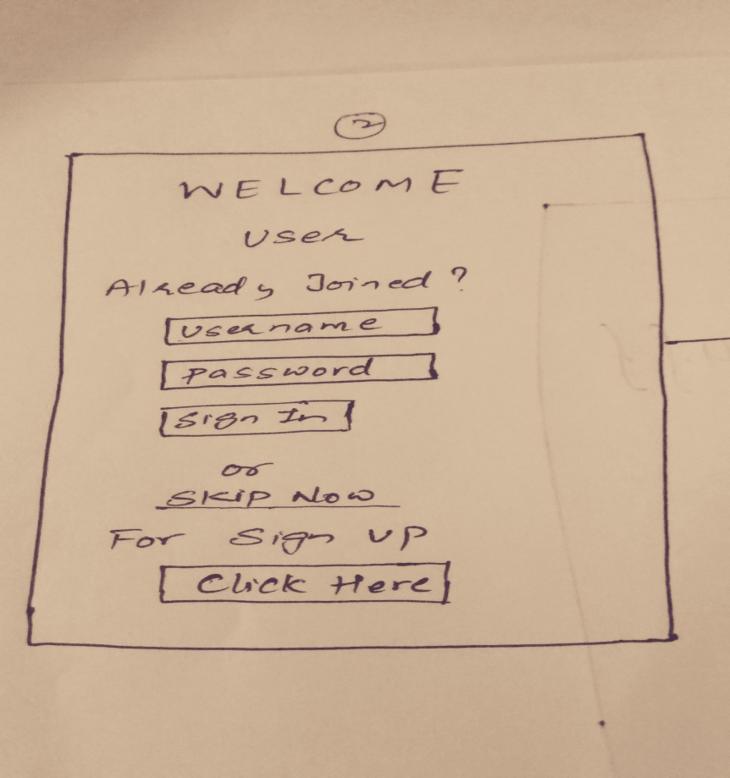
LOGIN PAGES
Paper prototype of this app has :
1.Login Page
2.Registration Form
3.List of available services
4.List of Service man available for that particular service.
5.Profile of Service man

Slide 10
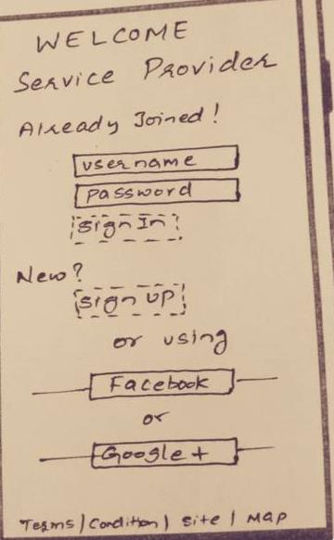
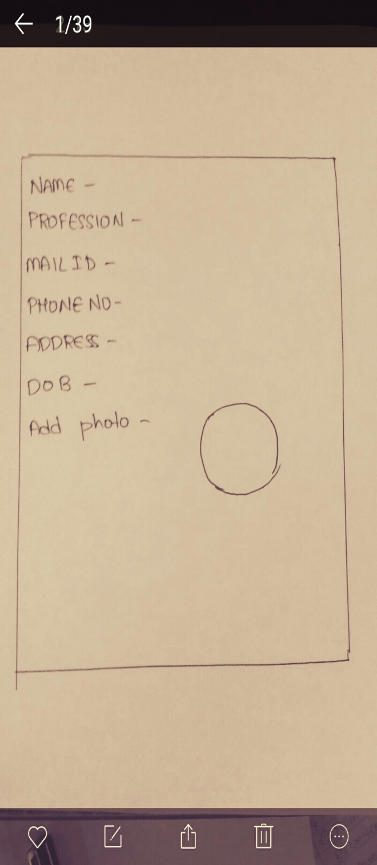
PAPER PROTOTYPE FOR APP
REGISTRATION PROCESS

Slide 11
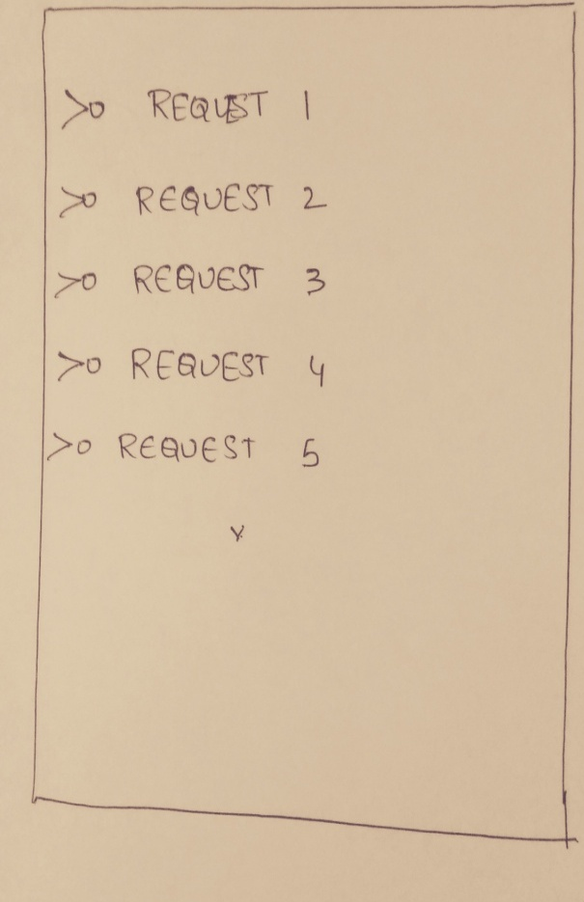
NOTIFICATIONS OF APPS
Tools Used:
POPAPP-paper prototyping
https://popapp.in/
Wire framing
https://balsamiq.com
Flow chart
https://creately.com/

Slide 12
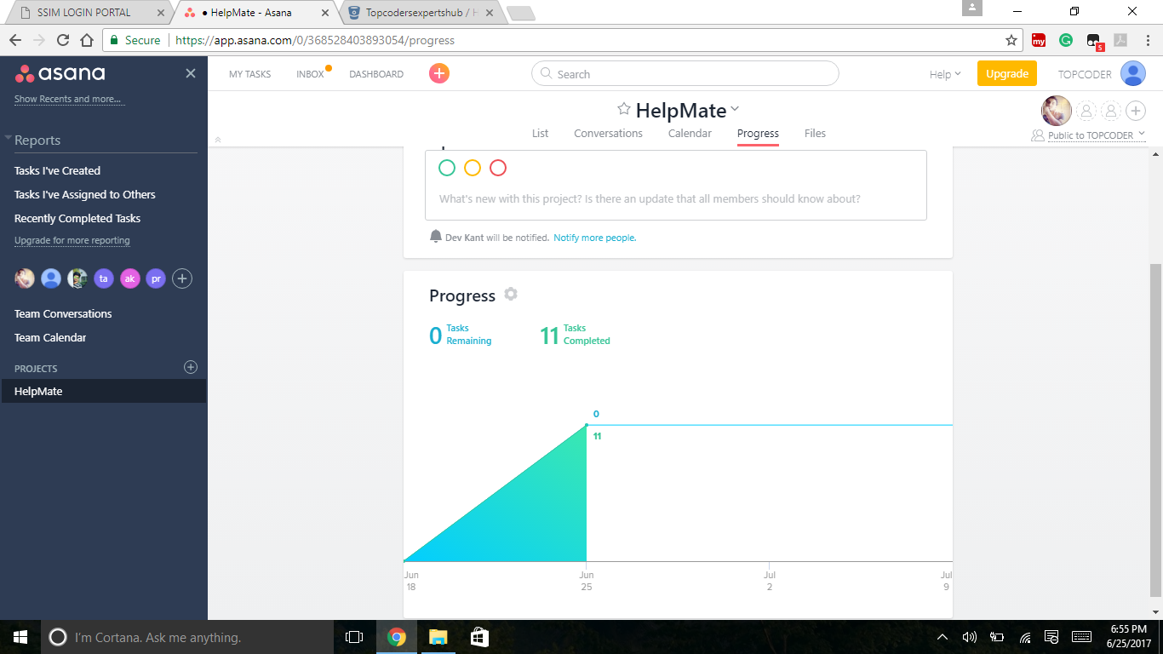
ASANA.COM – TASK SCHEDULE

Slide 13
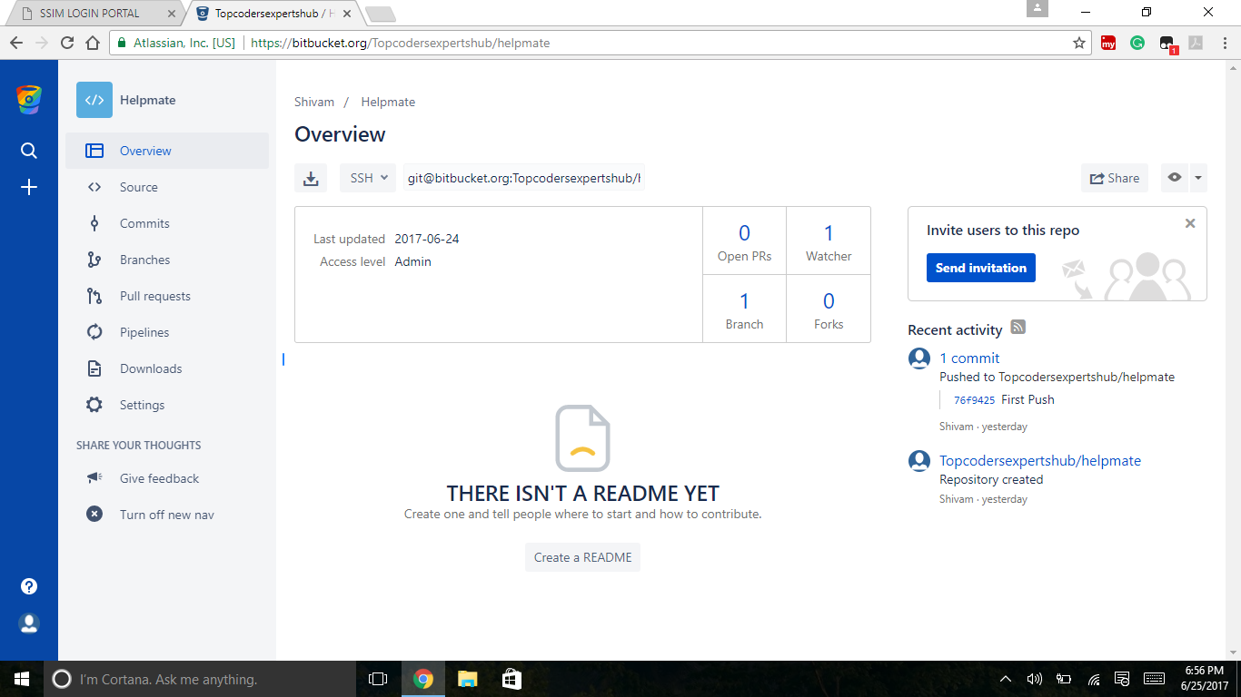
BITBUCKET WITH SMART GIT https://bitbucket.org/Topcodersexpertshub/helpmate

Slide 14
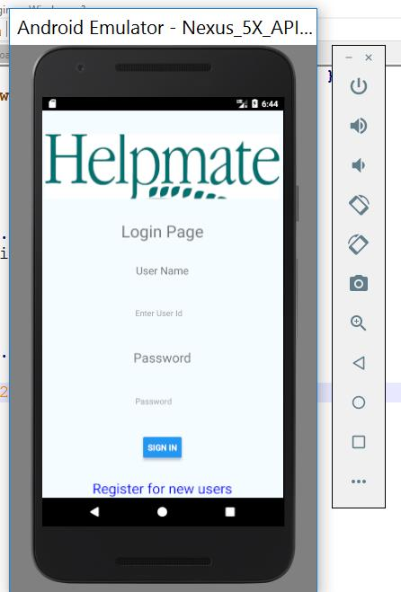
TECHNICAL DEVELOPMENT
Login Page:
User authentication is done in login page. Once the user details are verified it redirects to the dashboard .
Dashboard consists of all services.
It also has an option for a new user to register.

Slide 15
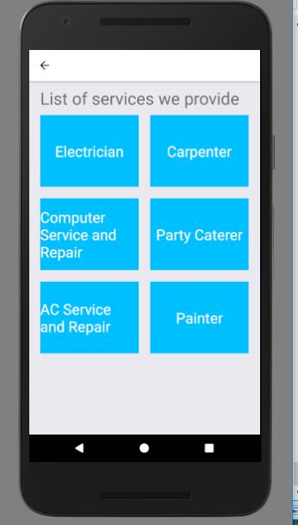
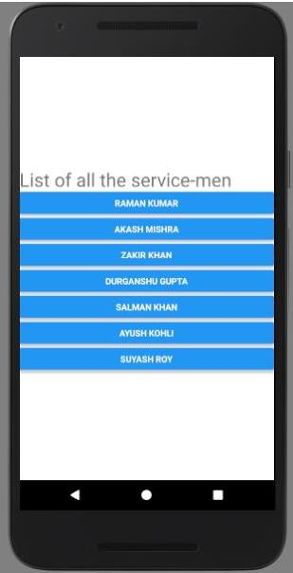
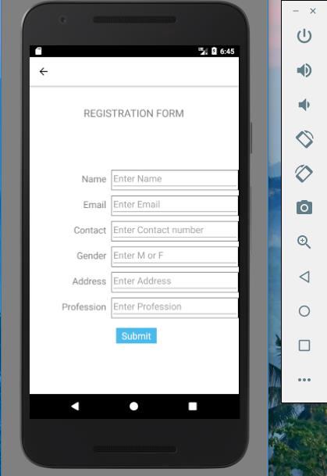
Technical workflow
Registration form provides an interface for new user to register .
Dashboard displays all available services.

Slide 16
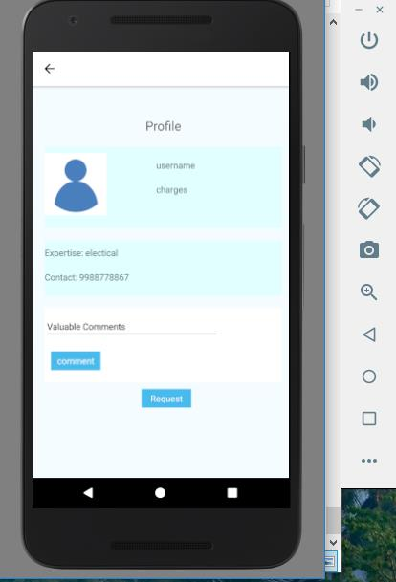
Customer can view details about service man in their profile.
Customer can share their problems to service man in
Comments sections.
Customer requests service by
With just one click on request button.

Slide 17
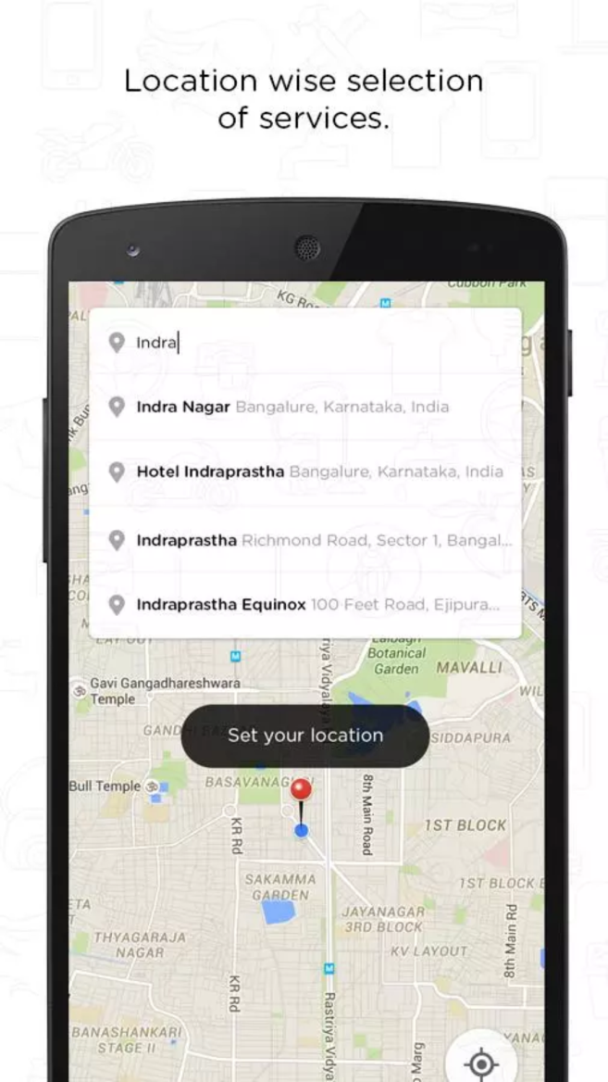
FUTURE DEVELOPMENT
Adding geolocation to our app.
With help of geolocation customer can find out what are the services available to him/her at that point.
Customer marks the location of where he wanted service and the app allocates the service man based on availability.

Slide 18
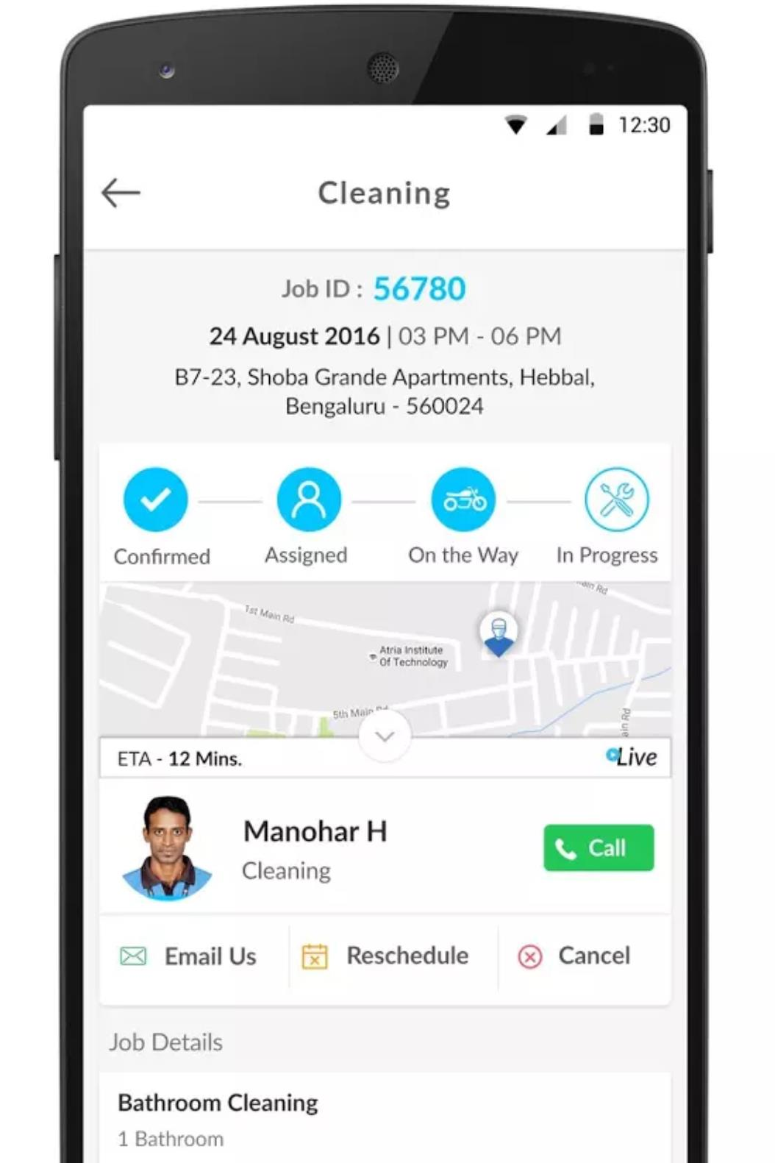
Live tracking
Live tracking is one feature we
want to add our app.
Live tracking tracks the exact status of the service.
Live track shows the exact location of service man.

Slide 19
ACKNOWLEDGEMENT
We express our kind gratitude to ExpertsHub team for bolstering us all the time and providing us the
obligatory information.
Special Thanks to Sagar Sir and Anshuman Sir.

Slide 20


